Slide 1

Experiencing M I S
Ninth Edition
Chapter Extension 4
Reporting Systems and O L A P
Slides in this presentation contain hyperlinks. JAWS users should be able to get a list of links by using INSERT+F7
Copyright © 2021, 2019, 2017 Pearson Education, Inc. All Rights Reserved
Notes:
If this PowerPoint presentation contains mathematical equations, you may need to check that your computer has the following installed:
1) MathType Plugin
2) Math Player (free versions available)
3) NVDA Reader (free versions available)

Slide 2
Study Questions
CE 4-1 How do reporting systems enable people to create information?
CE 4-2 What are the components and characteristics of reporting systems?
CE 4-3 How are reports authored, managed, and delivered?
CE 4-4 How are O L A P reports dynamic?

Slide 3
Reporting Applications
CE 4-1 How do reporting systems enable people to create information?
Create meaningful information from disparate data sources.
Deliver information to user on time.
Basic operations:
Filtering
Sorting
Grouping
Making simple calculations on the data
Notes:
A reporting application is a BI application that inputs data from one or more sources and applies reporting operations to that data to produce business intelligence.

Slide 4
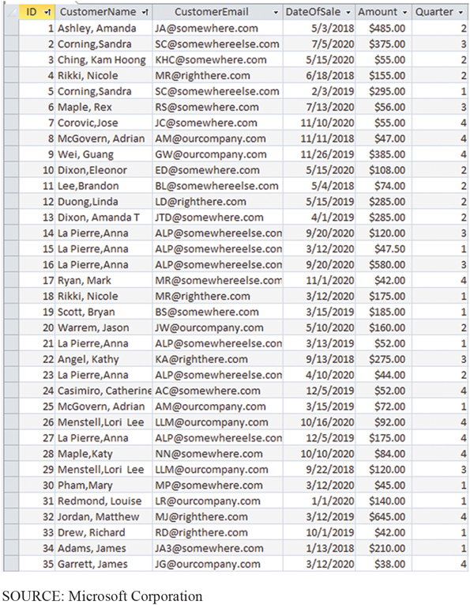
Raw Sales Data: List Contains Little Information
CE 4-2 What are the components and characteristics of reporting systems?
Figure C E 4-1 Raw Sales Data
Notes:
This partial list of raw data has no meaningful context. It is just a list of data—no information.

Slide 5
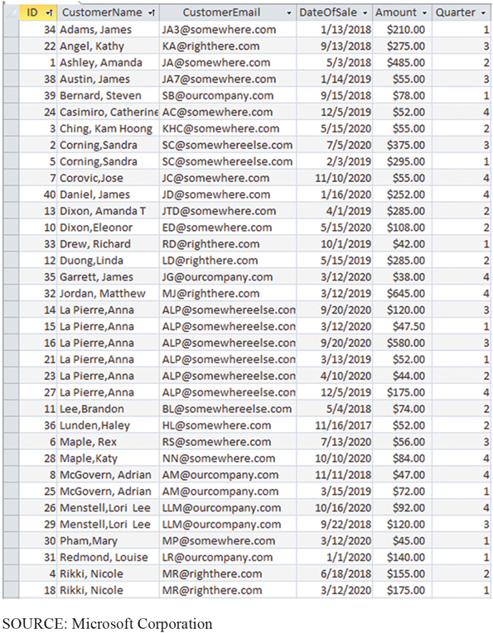
Sales Data Sorted by Customer Name
CE 4-2 What are the components and characteristics of reporting systems?
Figure C E 4-2 Sales Data Sorted by Customer Name
Notes:
Sorting by customer name can create a more meaningful context for this data.

Slide 6
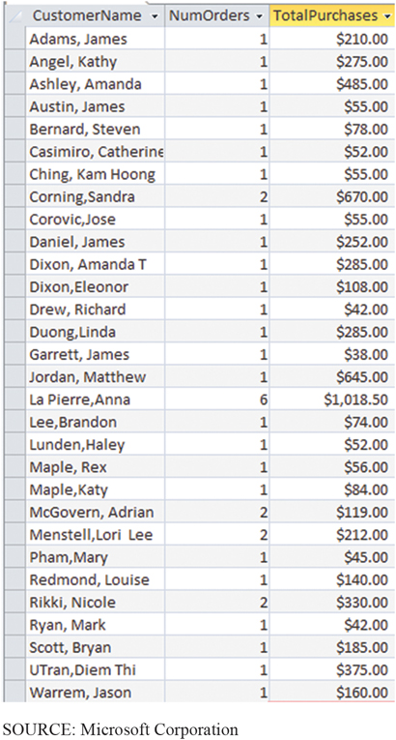
Data Sorted, Grouped, and Showing Total Purchases
CE 4-2 What are the components and characteristics of reporting systems?
Figure C E 4-3 Sales Data Sorted by Customer Name and Grouped by Number of Orders and Showing Total Purchases
Notes:
A reporting tool grouped orders and computed number of orders for each customer and total purchase amount per customer.

Slide 7
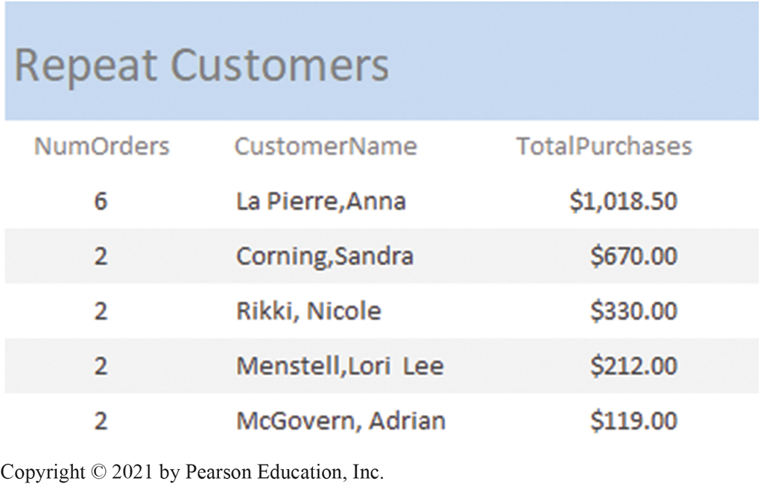
Data Filtered to Show Repeat Customers
CE 4-2 What are the components and characteristics of reporting systems?
Figure C E 4-4 Sales Data Filtered to Show Repeat Customers
Notes:
Report has filtered results and created a formatted display for easier understanding.
If your goal is to identify your best customers, this report shows data in a far more useful context and will save considerable work.

Slide 8
Reporting Systems
CE 4-2 What are the components and characteristics of reporting systems?
Reads and combines data from disparate data sources
Filters, sorts, groups, simple calculations to produce meaningful contexts
Metadata to prepare and deliver reports
Report characteristics
Type
Media
Mode
Notes:
A reporting system maintains a database of reporting metadata that describes reports, users, groups, roles, events, and other entities involved in reporting activity. Reporting systems use metadata to prepare and deliver reports to the proper users on a timely basis.

Slide 9
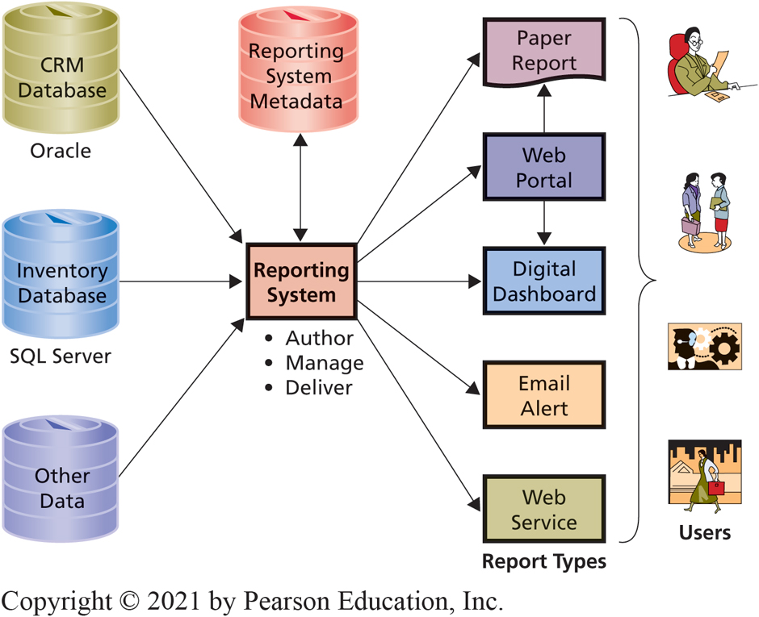
Components of a Reporting System
CE 4-2 What are the components and characteristics of reporting systems?
Figure C E 4-5 Components of a Reporting System
Notes:
Organizations can prepare reports in a variety of formats.

Slide 10
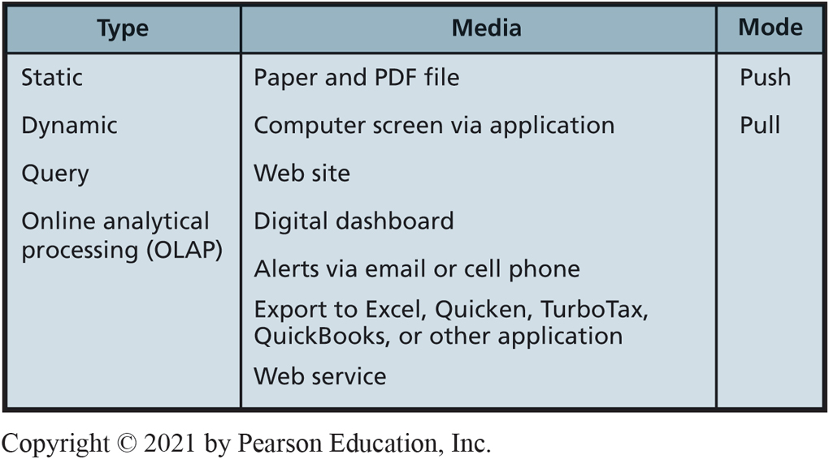
Summary of Report Characteristics
CE 4-2 What are the components and characteristics of reporting systems?
Figure C E 4-6 Summary of Report Characteristics
Notes:
Static reports are prepared once from underlying data, and do not change. A report of past year’s sales is a static report.
Dynamic reporting systems read most current data and generate reports using that fresh data; for instance, a report on sales today and a report on current stock prices.
Query reports prepared in response to requests entered by users.
OLAP reports allow user to dynamically change the report grouping structures.

Slide 11
Report Media
CE 4-2 What are the components and characteristics of reporting systems?
Printed on paper
P D F s—Portable Document Format
Delivered to computer screens and mobile devices
Applications for C R M and E R P systems
Digital dashboards
Alerts
Exported from report generator to another program
Published via Web service

Slide 12
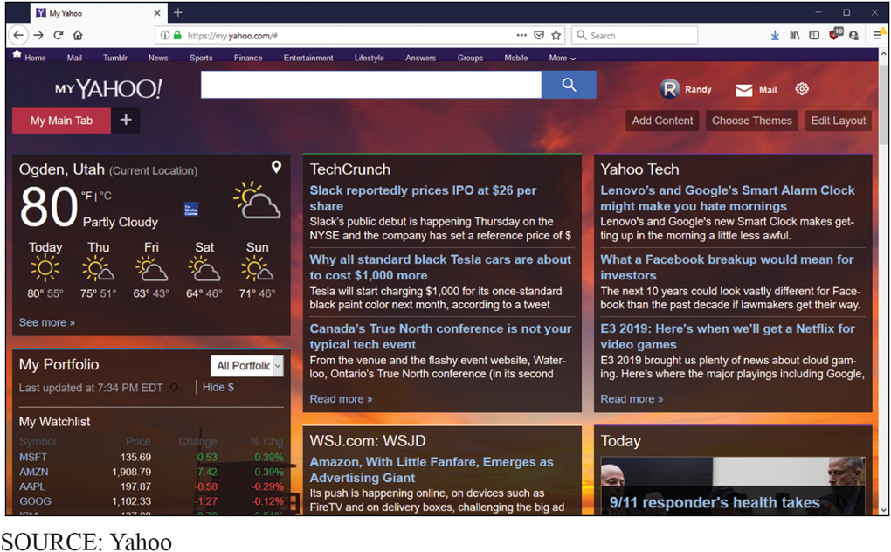
Digital Dashboard Example
CE 4-2 What are the components and characteristics of reporting systems?
Figure C E 4-7 Digital Dashboard Example
Notes:
Digital dashboard is a customized electronic display for a particular user. Vendors like Yahoo! and MSN provide common examples.
Users can define content they want—say, a local weather forecast, a list of stock prices, or a list of news sources—and the vendor constructs customized display for each user.

Slide 13
Report Mode
CE 4-2 What are the components and characteristics of reporting systems?
Types of reports
Push report
Sent or e-mailed to users according to a preset schedule
Pull report
Users download report from web portal or digital dashboard

Slide 14
Report Authoring and Management
CE 4-3 How are reports authored, managed, and delivered?
Report authoring
Connecting to data sources, create report structure, format report
Examples: M S Access, Visual Studio
Report management
Defines who receives what reports, when, what format, and by what means
Defines user accounts and user groups
Notes:
Report authoring involves connecting to data sources, creating the report structure, and formatting the report.

Slide 15
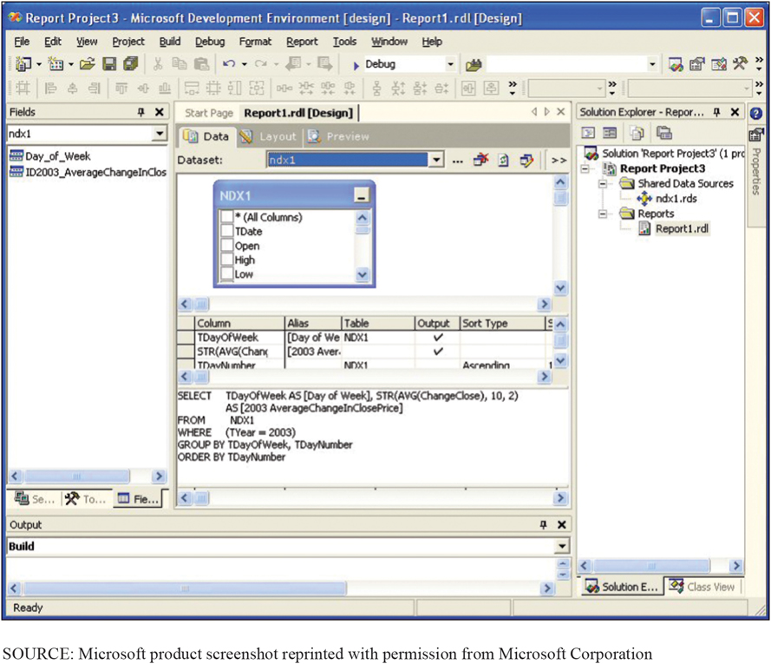
Connecting to a Report Data Source Using Visual Studio
CE 4-3 How are reports authored, managed, and delivered?
Figure C E 4-8 Connecting to a Report Data Source Using Visual Studio
Notes:
One common way to create reports is to use a developer tool such as Microsoft’s Visual Studio, which can connect to many different data sources.
Here Visual Studio connected to a database that contains source data and an SQL statement, shown in the lower-center portion of this display, to generate this report. Visual Studio can be used to format the report as well.

Slide 16
How are Reports Delivered?
CE 4-3 How are reports authored, managed, and delivered?
Report delivery function
Pushes or allows pulling reports based on metadata
Delivered via an email server, Web site, S O A services, or other program-specific means
Security components ensure only authorized users receive reports
For queries, serves as intermediary between users and report generator

Slide 17
O L A P Reports
CE 4-4 How are O L A P reports dynamic?
O L A P provides ability to sum, count, average, perform other simple arithmetic operations on groups of data
O L A P reports
Dynamic
Measure: item summed, averaged or processed in O L A P report
Dimension: category or class
Cube: measure with associated dimensions
O L A P vendors and products
Notes:
Measure is a data item of interest. Total sales, average sales, and average cost are examples of measures.
Dimension is a characteristic of a measure. Purchase date, customer type, customer location, and sales region are all examples of dimensions.
Visit www.Tableau.com to useful demos, tutorials and excellent examples.

Slide 18
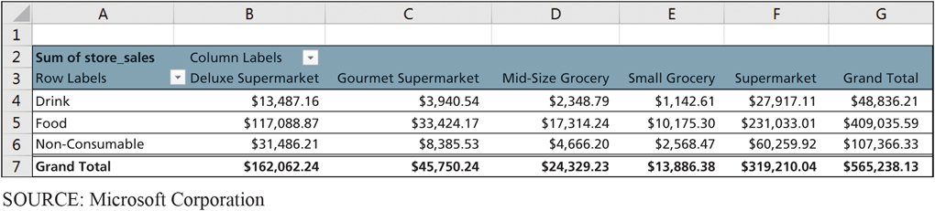
O L A P Product Family by Store Type
CE 4-4 How are O L A P reports dynamic?
Figure C E 4-9 O L A P Product Family by Store Type
Notes:
Generated by SQL Server Analysis Services and displayed in an Excel Pivot table.
Here, measure is Store Sales Net, and dimensions are Product Family and Store Type. This report shows how net store sales vary by product family and store type. Stores of type Supermarket sold a net of $60,259 worth of non-consumable goods.

Slide 19
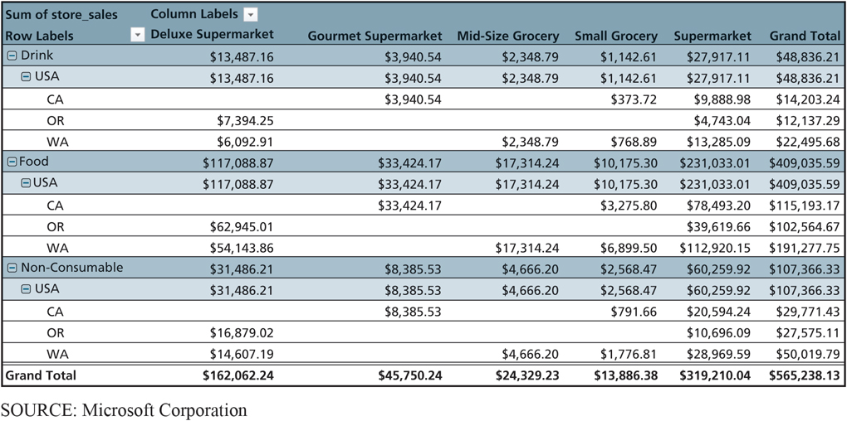
O L A P Product Family by Store Location and Store Type
CE 4-4 How are O L A P reports dynamic?
Figure C E 4-10 O L A P Product Family by Store Location and Store Type
Notes:
User added dimensions Store Country and Store State to the horizontal display. Product-family sales are now broken out by the location of the stores.
Observe sample data include only stores in the United States and only in the western states of California, Oregon, and Washington.

Slide 20
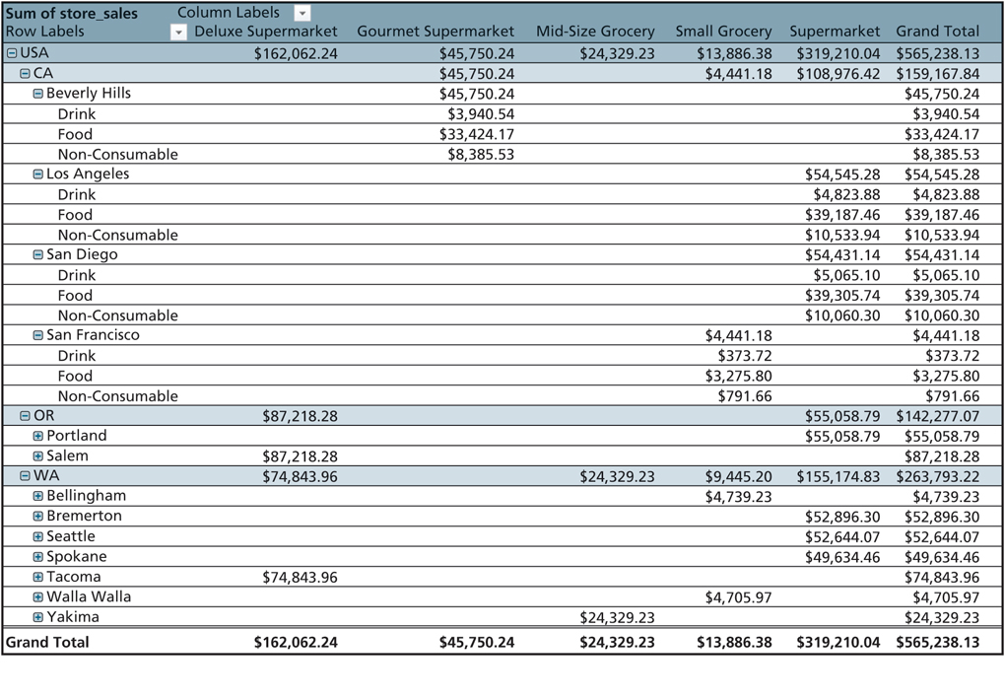
O L A P Product Family and Store Location by Store Type, Sales Data for Four Cities
CE 4-4 How are O L A P reports dynamic?
Figure C E 4-11 O L A P Product Family and Store Location by Store Type, Showing Sales Data for Four Cities
Notes:
User has drilled down to stores located in California; OLAP report now shows sales data for four cities in California that have stores.
Notice user drilled down and changed the dimensions order.

Slide 21
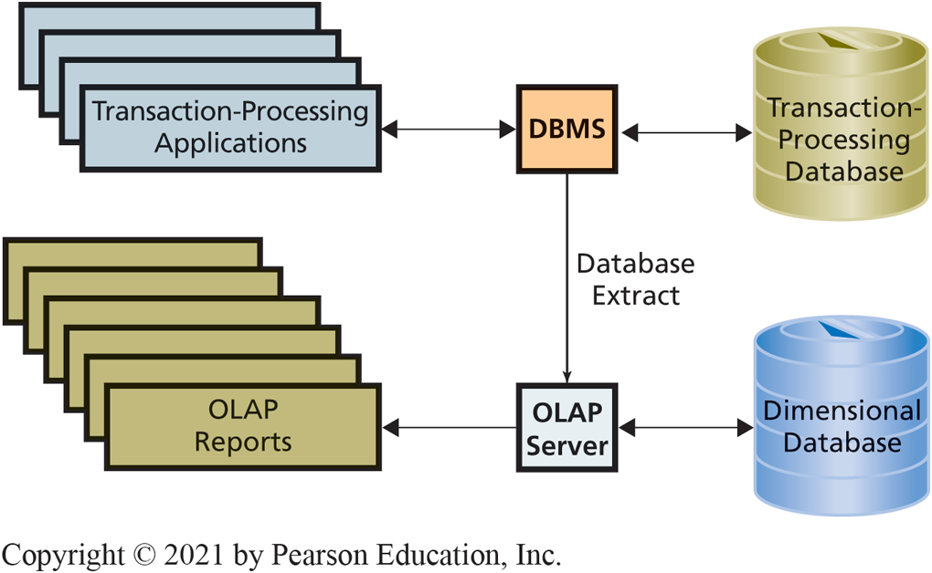
Role of O L A P Server and Dimensional Database
CE 4-4 How are O L A P reports dynamic?
Figure C E 4-12 Role of O L A P Server and Dimensional Database

Slide 22
Active Review
CE 4-1 How do reporting systems enable people to create information?
CE 4-2 What are the components and characteristics of reporting systems?
CE 4-3 How are reports authored, managed, and delivered?
CE 4-4 How are O L A P reports dynamic?

Slide 23

Copyright

